Slide 1

Auxiliary Braking. A performance based standard proposal
S. SAAVEDRA

Slide 2
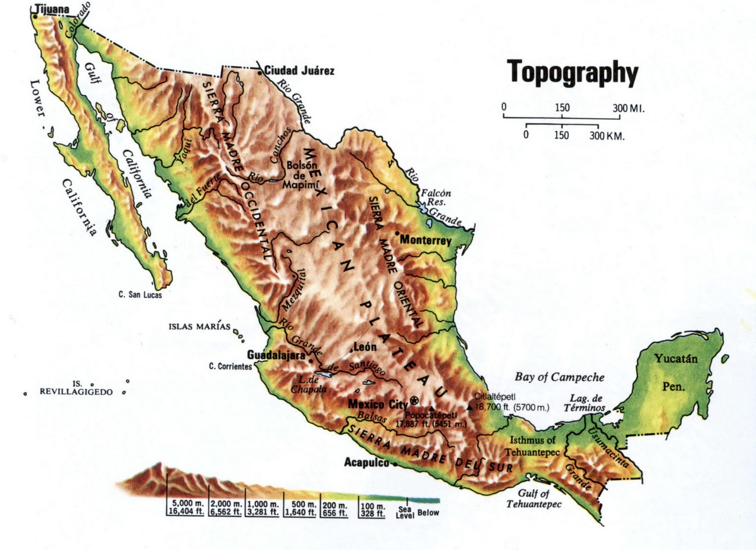

Mexico demography and topography
Population – 126 million as of 2020
More than 30% live at an altitute higher than 1,900 m ASL
35% of GDP comes from that region.

Slide 3
Some downhill road sections

Slide 4
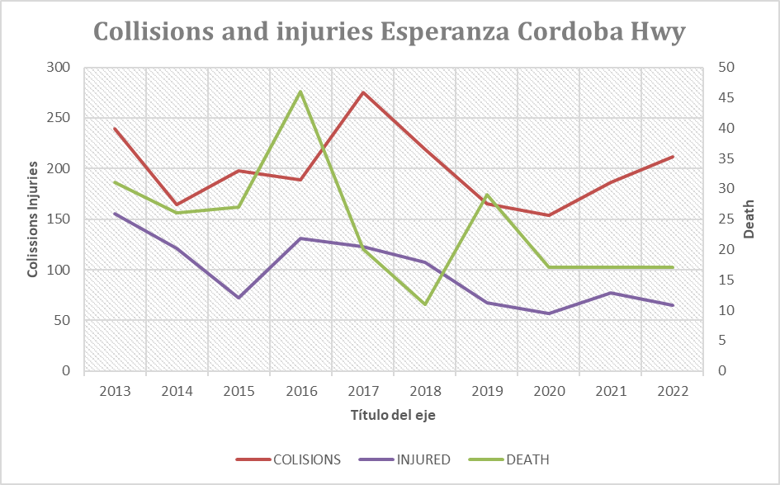
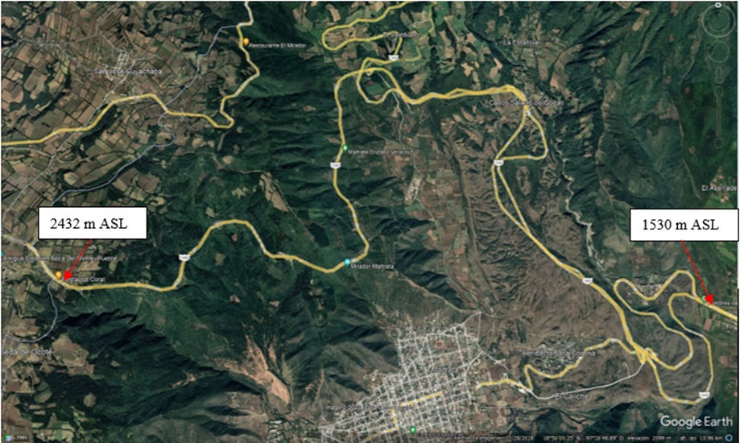
Road Safety. Esperanza Cordoba HWY
In 10 years:
Collisions – 2001
Fatalities – 241
Injuries – 975
Length of the road Section – 58 km

Slide 5
Typical vehicle configurations in Mexico
The NOM-012-SCT-2-2017 includes 28 different vehicle configurations,
4 for buses (B),
3 for unit trucks (C),
4 for trucks with trailer (C-R),
6 for truck tractor with semitrailer (T-S),
8 for truck tractor with semitrailer and full trailer (T-S-R) and
3 for truck tractor with two semitrailer (T-S-S)

Slide 6
Energy consideration on high altitude differences
Let’s compare the kinetic energy to be dissipated during a panic braking of the heaviest allowed configuration traveling at a speed of 80 km/hr:
With the potential energy of the same vehicle configuration at the top of the Esperanza - Cd Mendoza straight road section:
So
Ep ÷ Ec = 35.8 panic brakings @ 80 km/h
In a period of less than 15 minutes.

Slide 7
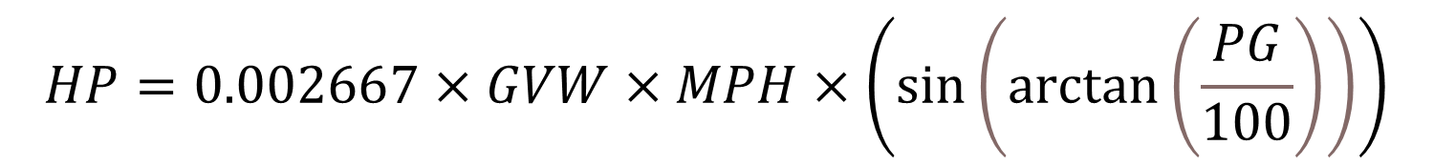
Formula in general units of meassure
The Technology and Maintenance Council of the American Trucking Associations in their Recommended Practice RP636-1 includes a formula that can be used to determine the horsepower (HP) that must be absorbed by the vehicle in order to maintain a given speed (MPH), when traveling downhill with a percent of grade (PG), with a gross vehicle weight (GVW). The formula is in imperial units as follows:
$$HP=0.002667×GVW×MPH×\left(\sin\left(\arctan\left(\frac{PG}{100}\right)\right)\right)$$
Considering that the result of $\left(\sin\left(\arctan\left(\frac{PG}{100}\right)\right)\right)$ is almost identical to PG/100 for grades up to 10% and calculating a new constant value for general units, I propose the use of the following formula:
$$kW=2.725×GVW×v×PG$$

Slide 8
Aerodynamics and rolling resistance
Aerodynamic drag
Truck and trailer designs have seen significant improvements in the last decade in terms of aerodynamics. In North America environmental regulations have imposed the use of aerodynamic devices to reduce fuel consumption and thus emissions. These improvements result in lower forces opposing to movement when traveling downhill and thus requiring more power from the auxiliary braking system.
$$F_{d}=c_{d}×0.5ρ×v^{2}×A$$

Slide 9
Aerodynamics and rolling resistance
Rolling resistance
Rolling resistance is defined as the force that resists the motion of a body rolling on a surface. It can be expressed by the following generic formula:
$$F_{r}=c×W$$
The total calculated forces that oppose to the movement of the vehicle configuration with dry van trailers are the aerodynamic drag force (Fd) + rolling resistance (Fr), and may be expressed in term of power considering the speed of travel of the vehicle as follows:
$$HP=\left(F_{d}+F_{r}\right)×v×1.341$$

Slide 10
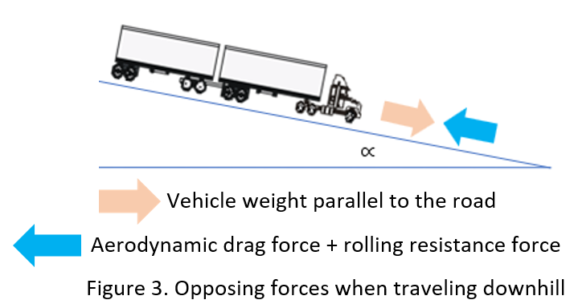
Theoretical formula for auxiliary braking power
The forces acting on the vehicle configuration. In our example for the analysis our vehicle configuration with a mass of 75,500 kg traveling on a 5% gradient requires a braking power of 826 HP to maintain a speed of 60 km/h.
$$HP=\left(F_{d}+F_{r}\right)×v×1.341=\left(910+4222\right)×\frac{60}{3.6}×1.341=114.7 HP$$
So the power of the forces that oppose to the movement is around 14% of the power needed to keep the speed of the dry van configuration and 13% of the low height flatbed configuration.
The theoretical formula for auxiliary braking power may be expressed as follows:
$$kW=2.725×GVW×v×PG×0.87$$

Slide 11
Theoretical formula for auxiliary braking power
Calculated braking power using the previous formula may be decreased by 13% for low height flatbed configurations or 14% for dry van type configurations. Other percentages may be used when practical tests are run to determine the natural retardation power of the vehicle configurations.
The other factor in selecting the auxiliary braking systems is the amount of energy that the system must dissipate during the downhill travel. Friction brakes have enough power to stop a vehicle, but they do have a limited capacity to dissipate the heat. If calculations indicate that, in order to maintain the speed on a downhill road, it is needed to apply a panic braking at cycles of every 3 minutes or less, more than 5 times, then an auxiliary braking system is needed for safe travel.

Slide 12
Are auxiliary braking systems needed in the Mexican highways?
NAME OF CONFIGURATION | HP min | MAX GVW (kg)
Unit truck with 3 axles (C3) | 215 | 27 500
3 axle truck tractor with the 2 axle semitrailer (T3-S2) | 350 | 46 500
3 axle truck tractor with 2 axle semitrailer and 4 axle full trailer (T3-S2-R4) | 450 | 75 500
Do the typical configurations have enough power to keep the vehicle at a speed of 60 km/h when traveling on the Esperanza - Cd Mendoza straight road section (4.54% PG)
NAME OF CONFIGURATION | Engine brake HP | Calculated AB HP | Calculated AB HP reduced by AD and RR
Unit truck with 3 axles (C3) | 107 | 273 | 238
3 axle truck tractor with the 2 axle semitrailer (T3-S2) | 175 | 540 | 470
3 axle truck tractor with 2 axle semitrailer and 4 axle full trailer (T3-S2-R4) | 225 | 752 | 654

Slide 13
Proposal of performance-based standard (PBS)
Purpose
The primary purpose of this standard is to manage the safety risk associated with the loss of service brake power due to overheating when traveling downhill.
Intent
When traveling downhill vehicles tend to gain speed by the conversion of potential energy into kinetic energy. In order to reduce the speed, drivers may apply the service brakes and/or use the engine brake. Service brakes usually have great braking power but may fade as temperature increases, or the heat generated may ignite the tires of the vehicle. Engine brake have limited power and can not be used for prolonged periods of time as the engine may get too hot. An auxiliary braking system independent of the service brakes with enough braking power and the ability to dissipate the heat generated without affecting other vehicle components is needed during steep and long road sections.
Detailed statement
When operating at maximum laden mass, a vehicle configuration participating in the scheme must be able to maintain steady forward motion speed on a road section with the specified downgrade during still air conditions.

Slide 14
Proposal of performance-based standard (PBS)
Performance value
The auxiliary braking system must be able to sustain a steady speed of the vehicle without applying the service brakes. The speed must be measured and recorded at the achieved performance value, in units of km/h rounded down to the nearest whole value.
Performance levels
Road classification | Downgrade | Length of road section (min) | Performance level required
ET and A | 5% | 10 km | 60 km/h
B | 6% | 6 km | 50 km/h
C and D | 8% | 4 km | 40 km/h
Test procedure
With the vehicle being assessed in forward motion on a slope having a downgrade as specified in the previous table, steady forward motion must be maintained at a speed not greater than the specified speed for the entire length of the road section. Steady forward motion is when the forward speed of the vehicle on the downgrade is either constant or decreasing for a period of at least 5 seconds. Numerical modeling is allowed.

Slide 15
Proposal of performance-based standard (PBS)
Implementation recommendations.
The PBS system.
There is no experience with the PBS system in Mexico. There is experience with prescriptive regulations only. So, an education process with all stake holders should be carried out before launching any PBS standard. It may be required to update the Quality Infrastructure Law to include PBS in it.
Auxiliary braking equipment.
Most of the truck tractors being sold in Mexico are manufactured following the US specifications, so they are not equipped with an auxiliary braking system beside the, so called, engine brake. An education process with all stake holders outlining the importance of the auxiliary braking system for the safety on downhill road section should be included in the process.
There should be an incentive for the transportation companies to be able to invest in auxiliary braking systems with the capacity required by this proposed PBS.

Slide 16
Proposal of performance-based standard (PBS)
Road signals.
Road signals and procedures must be updated so those road sections which require the use of auxiliary braking systems are clearly identified.
Implementation schedule.
The schedule to implement the systems should be agreed with the various transportation organizations. Initial demonstration tests should be carried out with the attendance of transportation representatives where it should be clear to them the advantages in safety they will have when equipping their trucks with auxiliary braking systems. Suppliers of the equipment needed should be included in the scheduling process, so there will be enough equipment by the time the PBS becomes mandatory.
Driver training.
Current driver training schedules should be updated to include the auxiliary braking procedures.

Slide 17
Conclusions
The auxiliary braking PBS should be useful to improve road safety on those road section with a downgrade greater than 4% and a length of over 3 km, as it will allow the service brakes to remain cool and thus effective to be used in case of the need to stop the vehicle the soonest in the shortest distance.
Engine brakes installed on tractors manufactured following the common specifications in the US do not have enough power to deal with the steep downhills in Mexico, when vehicle configurations travel at the heaviest GVW allowed.
Education and negotiations with transportation representatives are needed to schedule the implementation of the proposed PBS.

Slide 18

Thanks
Salvador Saavedra C.
salvador_saavedra@eti.mx

