Slide 1
Innovations in:
Intelligent Telematics & On-Board Weighing Technologies
Presented by: Paul Fenech, Co-Founder | V-DAQ
(02) 4204 8472 www.v-daq.com.au

Slide 2
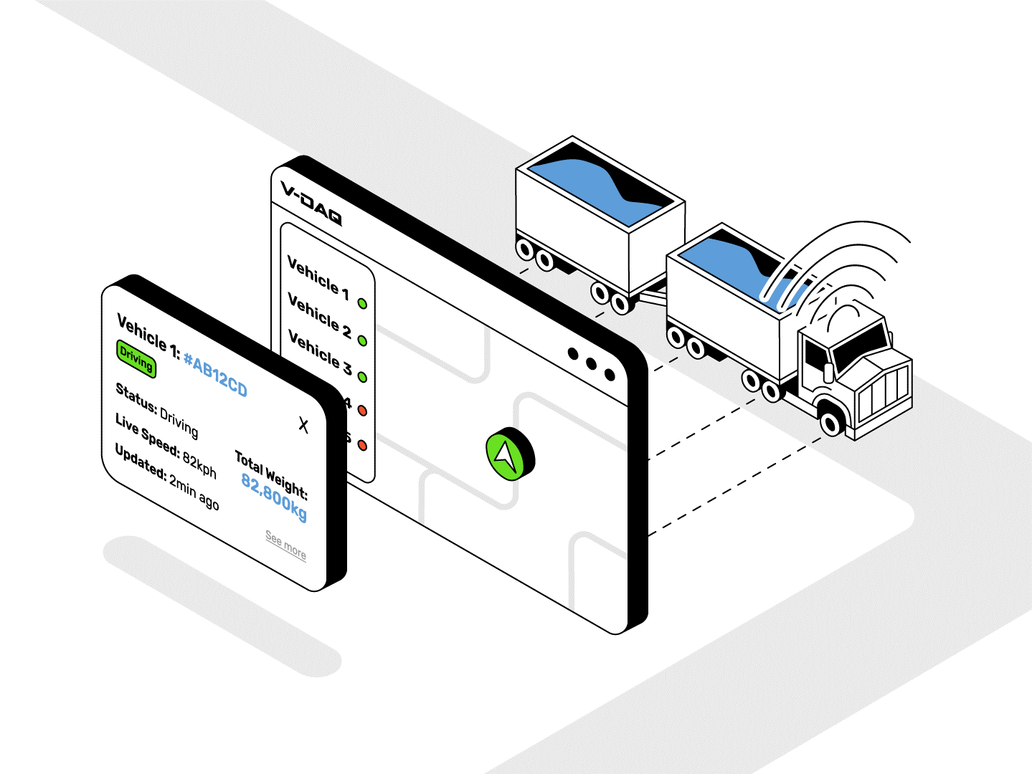
Who is V-DAQ?
Telematics provider specialising in regulatory.
We develop the hardware, software & manage service delivery & support.
Meeting specific data requirements in AUS.
Simple and scalable.
Innovations in Intelligent Telematics & On-Board Weighing Technologies
Innovations in Intelligent Telematics & On-Board Weighing Technologies
Notes:
Telematics Provider (specialising in regulatory)
Develop hardware/software/service delivery/support
Specific to meeting data requirements in Au
Location and Axle weights collected at relatively high frequencies
Simple and scalable

Slide 3
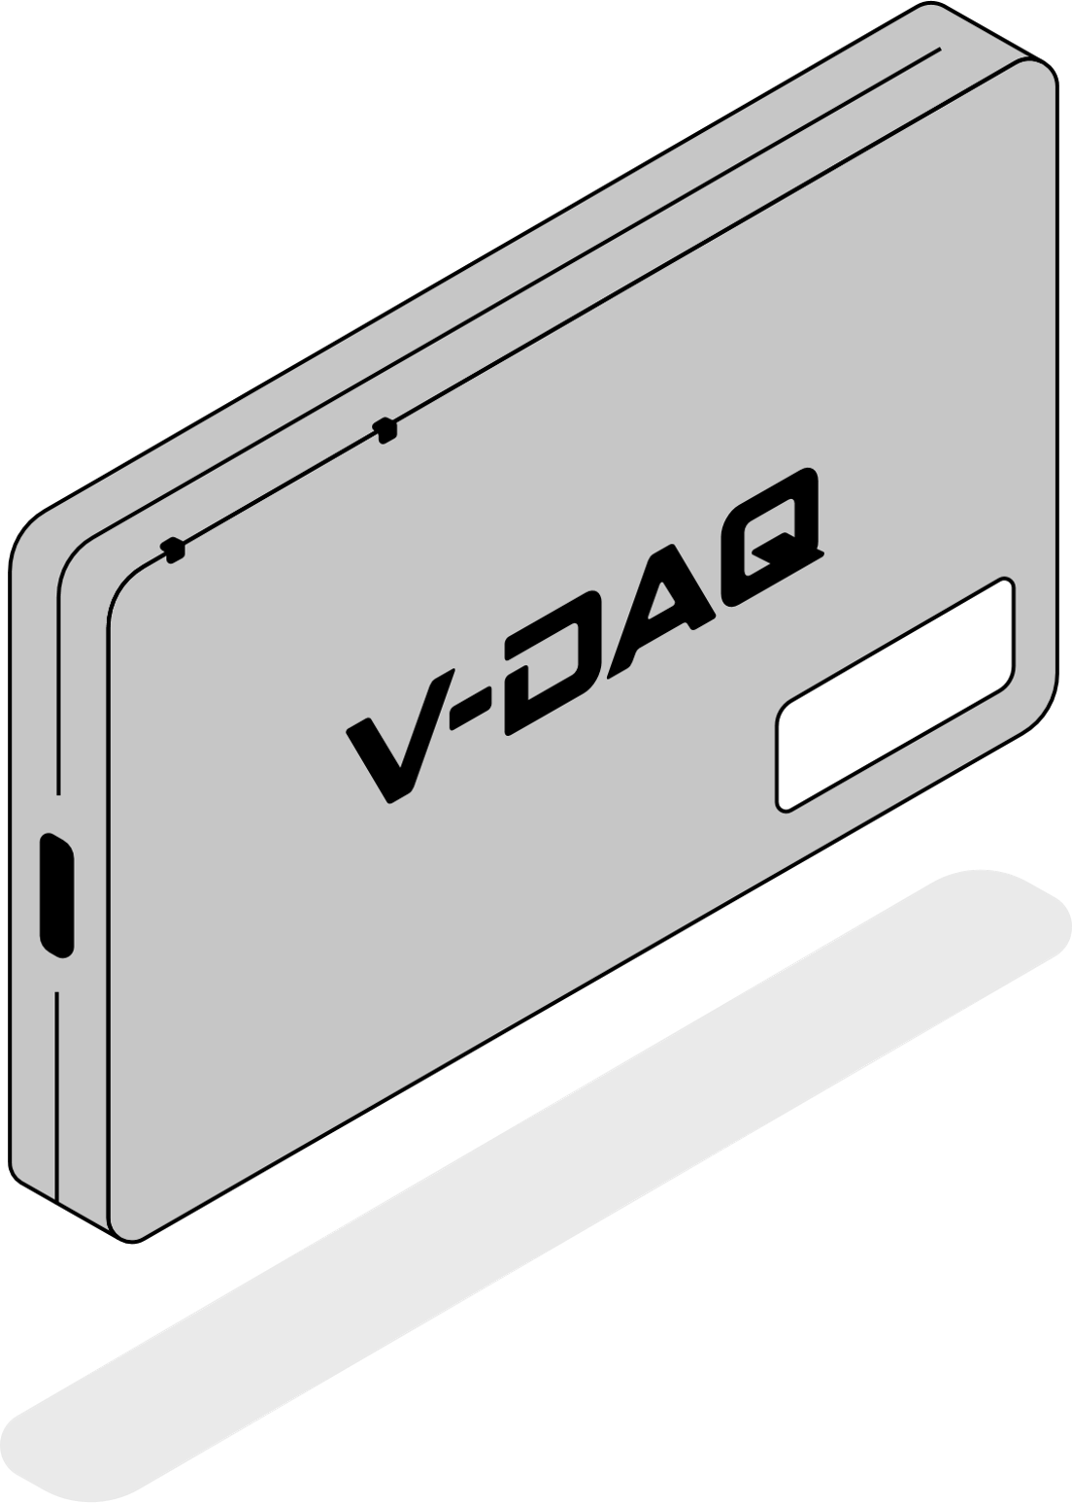
Our Innovation: Technology for our Industry
GPS/GNSS & 4G/5G connectivity.
Long-range Bluetooth.
Credit card sized Tag.
Self-installed in 20min.
Any vehicle, any brand, any age.
Ease of physical fulfilment.
Innovations in Intelligent Telematics & On-Board Weighing Technologies
Notes:
Hardware – not black box, but intelligent transport tag.
We design and manufacture this as a core innovation for us to collect and distribute the data that matters.
This is our enabler for our impact on industry, retrofittable
- Cellular and GPS/GNSS
- Self-installed, on the windshield just like a toll tag, one power cable.
- 20min installation
- Ease of fulfilment, it's like ecommerce, shipped out in boxes, self-installed.
- If problems arise, a simple swap and go replacement, no technicians, not professional skills required.
- Our core enabling us to collect on-board weighing dat

Slide 4
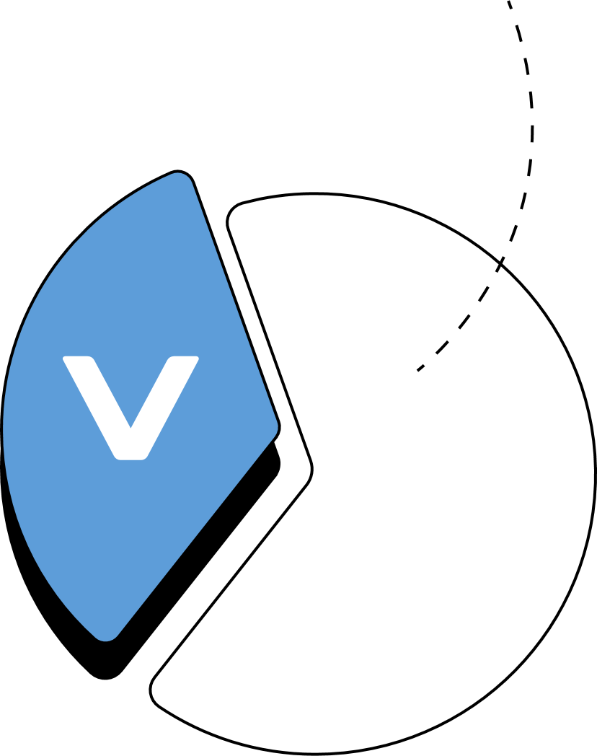
Our Story
Australian
Transport Operators
In less than three years, 30% of Freight Operators now use V-DAQ services for their regulatory telematics requirements.
But how did we get here?
2021
2022
2023
Innovations in Intelligent Telematics & On-Board Weighing Technologies
Notes:
Interesting history of our entry and success in the market
- Listened to industry
- Tailored products and services to them
We had a can-do attitude with a focus on SIMPLCIITY, all aspects of the business are focused on SIMPLCITY
We support and drive the success of the National Telematics Framework
- Hardware and installation
- New technology innovations in smart OBM “Convergence”
- Education and onboarding
- Ongoing service management
Drove us to where we are enow representing 30% of operators in 3 years.
That’s a big challenge
All remotely and online
Challenging demographic

Slide 5
Our Story
Australian
Transport Operators
Listened to Industry.
Tailored products & services.
Ensured tangible benefits for operators (increased ROI etc.)
2021
Focused simplicity of all aspects for success.
2022
2023
Driving the success of the National Telematics Framework.
Innovations in Intelligent Telematics & On-Board Weighing Technologies
Notes:
Interesting history of our entry and success in the market
- Listened to industry (dot)
- Tailored products and services to them (dot)
- Outcome has driven the success of the National Telematics Framework
We had a can-do attitude with a focus on SIMPLCIITY, all aspects of the business are focused on SIMPLCITY
We support and drive the success of the National Telematics Framework
- Hardware and installation
- New technology innovations in smart OBM “Convergence”
- Education and onboarding
- Ongoing service management
Drove us to where we are enow representing 30% of operators in 3 years.
That’s a big challenge
All remotely and online
Challenging demographic

Slide 6
How Did We Deliver This?
Complex technology, with a simple customer experience.
Ongoing change management.
Easy fulfilment & installation.
Digital onboarding & support.
All done entirely online
Low-touch wireless connectivity for On-Board Weighing systems.
Innovations in Intelligent Telematics & On-Board Weighing Technologies
Notes:
Simple customer experience for complex technogy
Fifillemnt and Instalaltion
Digital onboarding and supoport
Wireless connectivoity for On-Board Weighting (low toich)
Ongoing change manqagemtn
- Online signup
- Ecommerce style dispatch and return system
- Self-installed
- Automated quality control and assurance using data
- Digital comms with government bodies,
including automated PDF certificate generation and
digit change management. Most importantly ongoing change
- wireless, flexible connectivity with OBM systems.
All of this, done entirely ONLINE

Slide 7
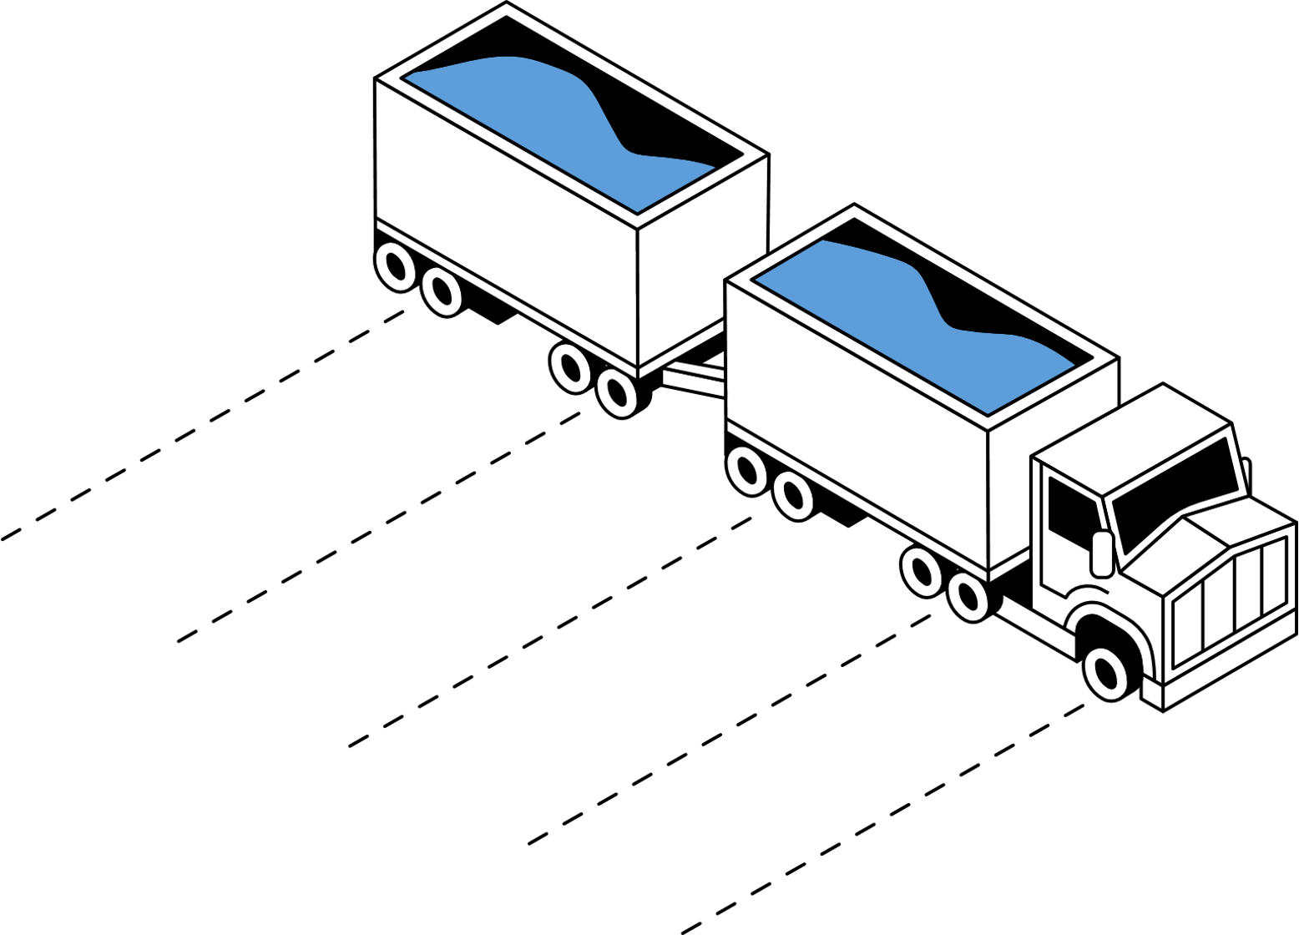
Our Innovation: Making On-Board Mass Accessible
Current OBM systems are locally interconnected on the vehicle.
Low cost, scalable, simple & efficient to set-up.
16,700kg
16,800kg
17,100kg
Provide genuine value to operators.
16,500kg
6,400kg
Innovations in Intelligent Telematics & On-Board Weighing Technologies
Notes:
Slide 1
Current OBM systems are interconnected locally
Low cost, scalable, simple & efficient to set-up.
Genuine value to businesses
Slide 2
We collect data wirelessly
We manage the quality and assurance ongoing
Realised the importance for visabilit and management outside of the vehicle.
Our relevant in “convergence” and weighting technologies.
Supporting current OBM systems
Developing tools to better manage these technologies at scale.
most relevant to this conference -> our display
First solution to support multiple wireless mass sensors in one combination wirelessly, retrofittable
Low-cost, scalable.

Slide 8
Our Innovation: Making On-Board Mass Accessible
We collect data wirelessly.
We manage the ongoing quality & assurance.
16,700kg
16,800kg
Realise the importance for remote visibility and vehicle management.
17,100kg
16,500kg
6,400kg
Innovations in Intelligent Telematics & On-Board Weighing Technologies
Notes:
Slide 1
Current OBM systems are interconnected locally
Low cost, scalable, simple & efficient to set-up.
Genuine value to businesses
Slide 2
We collect data wirelessly
We manage the quality and assurance ongoing
Realised the importance for visabilit and management outside of the vehicle.
Our relevant in “convergence” and weighting technologies.
Supporting current OBM systems
Developing tools to better manage these technologies at scale.
most relevant to this conference -> our display
First solution to support multiple wireless mass sensors in one combination wirelessly, retrofittable
Low-cost, scalable.

Slide 9
How it Works: Wireless OBM
Taking the brains out of the truck, into the cloud.
Each truck/trailer is a digital asset.
Innovations in Intelligent Telematics & On-Board Weighing Technologies
Notes:
“takes the brains out of the truck and into the cloud”
“Each trailer is own digital asset”

Slide 10
Our Innovation: Wireless OBM Benefits
Flexibility and technology interoperability.
High assurance and reliability.
Weights & vehicle classification.
Ability to remotely manage and control.
Brand agnostic system.
Framework for further automation.
Innovations in Intelligent Telematics & On-Board Weighing Technologies
Notes:
Benefits:
- Flexibility and technology interoperability
- Ability to remotely manage and control
- Framework for further automation
- High assurance and reliability

Slide 11
Case Study: McColl’s Transport
Had their own existing OBM system.
We made it work with a V-DAQ purpose fit solution.
Installing our first 20 units has been a simple and straight forward process. We are already realising mass gains. Love the product!
Managing quality assurance is McColl’s responsibility.
Fleet Improvement & Data Manager – McColl’s Transport
Innovations in Intelligent Telematics & On-Board Weighing Technologies
Notes:
Main concept WOBM is a tipping point for cost of purpose-fit solutions that outweighs utilising existing equipment or solutions.
- McColl's has own OBM system we supported and made it work

Slide 12
Case Study: McColl’s Transport
McColl’s is now implementing Wireless OBM across their fleet and seeing a range of benefits:
Lower overall costs & ongoing responsibilities.
Higher precision data directly increased payload by 800kg, lowering error margins.
Greater visibility, control & flexibility.
Meets both their regulatory and business ambitions.
Innovations in Intelligent Telematics & On-Board Weighing Technologies
Notes:
The realised the benefits of the WOBM product and ongoing service delivery having higher ROI
- Lower overall cost
- QA and ongoing service delivery shifted away from them
- Higher precision (800kg extra payload lowering error margins), making more money
- Example of the turning point (tech is delivering value to customers, meeting gov requirements, positive ROI)
Main concept WOBM is a tipping point for cost of purpose-fit solutions that outweighs utilising existing equipment or solutions.
- McColl's has own OBM system we supported and made it work
- This system gives them visibility, control, flexibility
- Less cost to maintain
- Higher precision and lower error margins (they have increased payload directly)
- Example of the turning point at how this technology is ready to scale, is cost effective,
- Cherry on the top is there is huge business benefits for them to know there weight al any point in time.

Slide 13
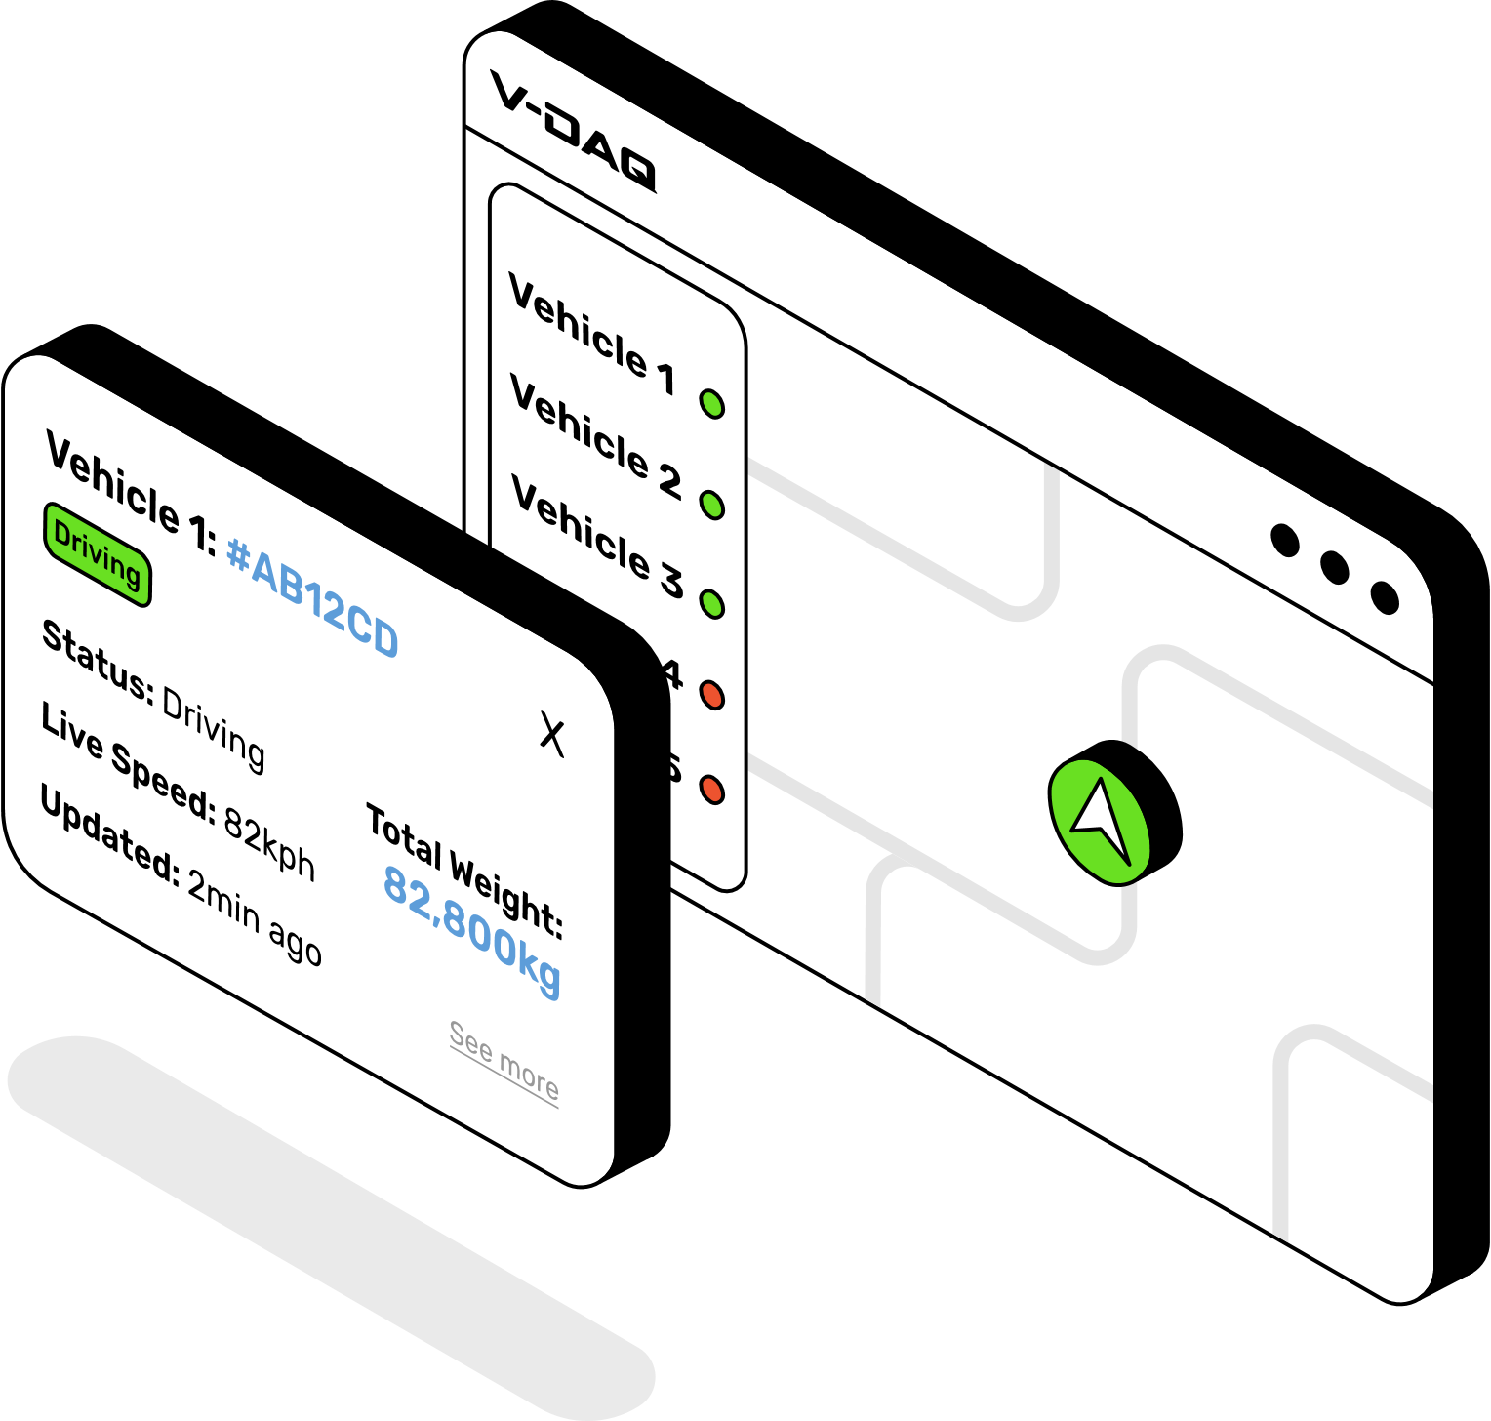
Today’s Takeaways: OEM’s & Suppliers
Come and talk to us about how our technology can work together.
Innovations in Intelligent Telematics & On-Board Weighing Technologies
Notes:
OEM’s, suppliers, academics, work with us to better define the future of this technology and its part in our industry.

Slide 14
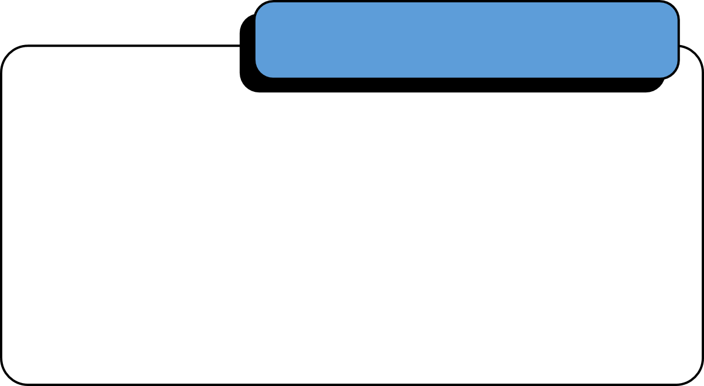
Today’s Takeaways: Governments & International Guests
Governments in Australia/overseas These technologies are ready to be used at scale. Importance to consider service delivery as part of the framework.
Get in contact!
(02) 4204 8472
info@v-daq.com
www.v-daq.com.au
For those interested: Talk to us about implementing our technology for your requirements.
Innovations in Intelligent Telematics & On-Board Weighing Technologies
Notes:
Considerations for service delivery needs to be part of the framework.
Government in AUS and overseas, the technology and service is ready to go for your next endeavours.
For other markets who have similar problems. If we did it for our vehicles, we can do it for yours.

